Slide 1
Web Based Student Mark List Management System Using PHP

Slide 2
PONDICHERRY UNIVERSITY COMMUNITY COLLEGE
Guided by : D. GAYA M.sc., M.Phil.M.Tech(cse).,(Ph.D.)
Associate Professor, PUCC.
Presented By:
SAM SUVARTS. S – 20CA0437
PRIYADHARSHAN. R- 20CA0432
JANARTHANAN. P -20CA0418
THOMAS SANTHANASAMY. A -20CA0447

Slide 3
Introduction
In today's digital age, there is a growing need for web-based applications that can help to automate tasks and improve efficiency.
One such application is a web-based student mark list management system.
This system can be used to store and manage student mark lists, which can save time and effort for teachers and administrators.
In this project, we will develop a web-based student mark list management system using PHP.

Slide 4
EXISTING SYSTEM
The system starts with registration of new staff and students. When the subjects are to be allocated to the faculty, the Head of the Department should enter everything in the Database. Then the staff enters corresponding subject's attendance and marks of the student then those must also be entered in the Database.

Slide 5
DRAWBACKS OF THE EXISTING SYSTEM
Not user friendly
Difficulty in report generation
Manual control
Lots of paperwork
Time consuming

Slide 6
Proposed System:
The “Web Based Student Mark List Management System Using PHP” of the organization is developed to overcome the most of the problems occurring in the manual system by computerizing the existing system. The features of the newly proposed computerized system are described in brief as below.
Advantages:
• Time consumption is reduced.
• Easy to enter details about teachers and students. Easy to search, edit and update. A secure student registration/authentication system.

Slide 7
System Requirements
The system will be developed using PHP, MySQL, and HTML/CSS.
The system will be hosted on a web server.
The system will be accessible to teachers and administrators via a web browser.

Slide 8
System Architecture
The system will be divided into three main components: The database component will store all of the student mark data.
The application component will provide the user interface for managing the student mark data.
The web server component will deliver the application component to users.

Slide 9
System Features
The system will allow administrators to:
Add Course, Fees details , Student Registration
Add student internal mark data,
Student Exam Registration
Generate reports on course-wise

Slide 10
System Benefits
The system will provide a number of benefits for teachers and administrators, including:
Increased efficiency: The system will automate many of the tasks involved in managing student data, which will save time and effort for teachers and administrators.
Improved accuracy: The system will help to ensure that student data is accurate and up-to-date.
Increased flexibility: The system will be flexible enough to meet the needs of different course and departments.

Slide 11
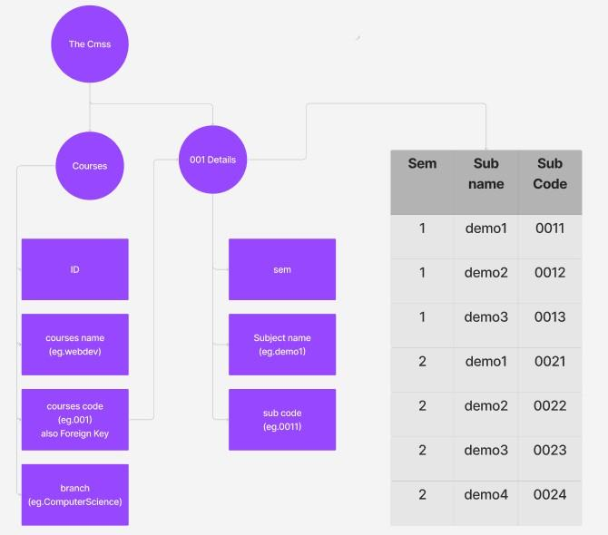
Database Design:

Slide 12
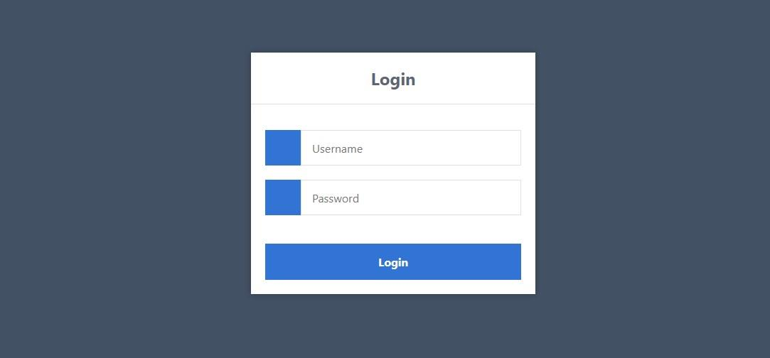
SCREEN SHOTS – LOGIN PAGE

Slide 13
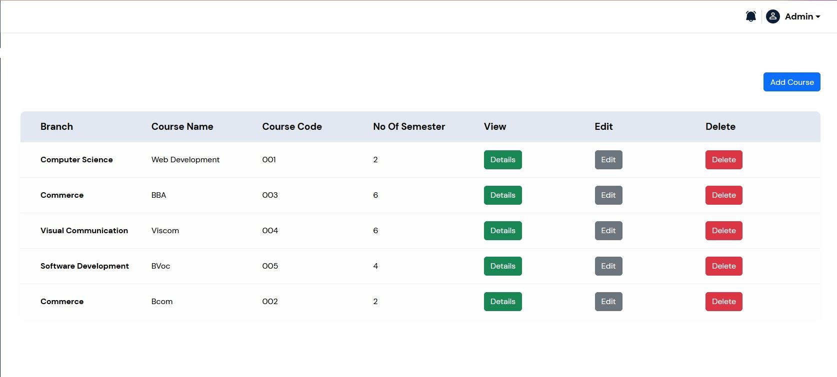
Course page:

Slide 14
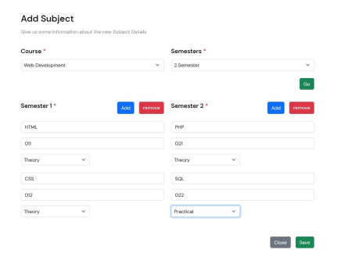
Add Subject Page:

Slide 15
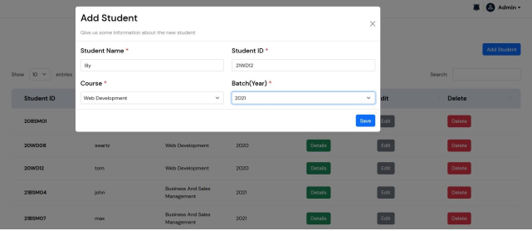
Add Students Page:

Slide 16
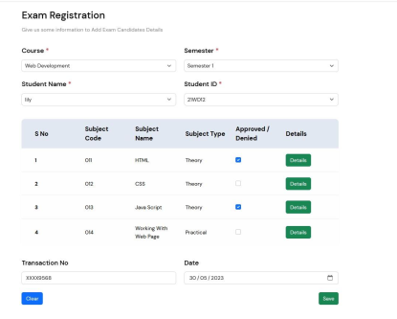
Exam Registration Page

Slide 17
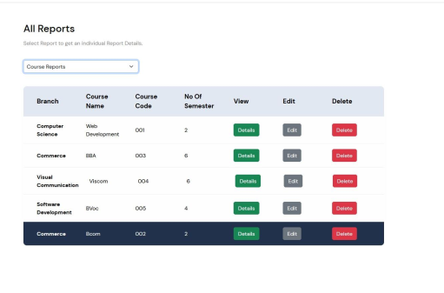
Reports page:

Slide 18
Conclusion
In conclusion, we have developed a web-based student mark list management system using PHP.
The system will provide a number of benefits for teachers and administrators, including increased efficiency, improved accuracy, and increased flexibility.
We believe that this system will be a valuable tool for schools and departments that are looking to improve the management of student mark data.

Slide 19
References
[1] "PHP Tutorial." W3Schools, www.w3schools.com/php/.
[2] "MySQL Tutorial." W3Schools, www.w3schools.com/sql/.
[3] "HTML Tutorial." W3Schools, www.w3schools.com/html/.
[4] "CSS Tutorial." W3Schools, www.w3schools.com/css/.

Slide 20
Thank you..!

